Slide 1
Interim Results for the
Six Months
ended 31 December 2009

Slide 2
STATEMENT OF COMPREHENSIVE INCOME RE-ANALYSED
Revenue from continuing operations 4 576 4 142 10%
Cost of Sales (2 441) (2 232)
Gross Profit 2 135 1 910 12%
Net operating expenses (925) (730)
Other operating income 151 4
EBITA 1 361 1 184 15%
Amortisation (47) (48)
Operating profit 1 314 1 136 16%
Net funding costs (173) (239)
Share of after tax loss of associates (1) (2)
Profit before tax 1 140 895 27%
Tax (251) (218)
Profit after tax from continuing operations 889 677 31%
EPS from continuing operations 240.6 cents 188.7 cents 28%
HEPS from continuing operations 242.3 cents 190.2 cents 27%
6 Months Ended
31 Dec 2009
R’m
6 Months Ended
31 Dec 2008
R’m
% Change

Slide 3
THE GSK TRANSACTIONS
Completed 1 December 2009
Contribution for one month – in line with guidance
68.5 million ordinary shares issued at R66.80 per share
Transaction value of R4.6 billion
Goodwill of R300 million
South African transaction:
100% of revenue disclosed by Aspen
Sub-Saharan Africa collaboration:
Statement of comprehensive income – profit only
Segmental – 100% of revenue disclosed with reconciliation

Slide 4
ANALYSIS OF SEGMENTAL REVENUE

Slide 5
REVENUE BY MARKET – DOMESTIC BRANDS
SOUTH AFRICA 2 550 2 066 23%
South Africa - Pharmaceuticals 1 975 1 525 30%
South Africa - Consumer 575 541 6%
SUB-SAHARAN AFRICA 279 464 -40%
INTERNATIONAL 974 917 6%
Asia Pacific 522 484 8%
Latin America 345 408 -15%
Rest of the World 107 25 334%
TOTAL 3 803 3 447 10%
6 Months Ended
31 Dec 2009
R’m
6 Months Ended
31 Dec 2008
R’m
% Change

Slide 6
REVENUE BY MARKET – GLOBAL BRANDS
Asia Pacific 227 159 43%
Latin America 154 110 40%
EMENA 414 393 5%
Rest of the World 29 34 -15%
Total 824 696 18%
6 Months Ended
31 Dec 2009
R’m
6 Months Ended
31 Dec 2008
R’m
% Change

Slide 7
ANALYSIS OF SEGMENTAL EBITA

Slide 8
SEGMENTAL MARGINS
SOUTH AFRICA * 29% 26%
South Africa - Pharmaceuticals 32% 29%
South Africa - Consumer * 17% 18%
SUB-SAHARAN AFRICA 16% 17%
INTERNATIONAL 27% 28%
GROUP * 28% 26%
6 Months Ended
31 Dec 2009
6 Months Ended
30 June 2009
* EBITA % has been normalised to exclude compensation for loss of profits received from insurers in respect of Aspen Nutritionals

Slide 9
FUNDING COSTS
Interest paid 281 311
Interest received (91) (116)
Net interest 190 195
Preference share dividends 14 21
Notional interest on financial instruments 1 (3)
Foreign exchange and fair value losses/(gains) (32) 26
Net funding costs 173 239
6 Months Ended
31 Dec 2009
R’m
6 Months Ended
31 Dec 2008
R’m

Slide 10
ABRIDGED BALANCE SHEET
ASSETS
Non-current assets 11 564 6 921
Tangible fixed assets 2 952 2 374
Goodwill 688 398
Intangible assets 7 850 4 104
Investment in associates 21 22
Other non-current assets 53 23
Current assets 4 593 3 536
Cash 1 960 2 065
TOTAL ASSETS 18 117 12 522
EQUITY & LIABILITIES
Capital & reserves 9 713 4 263
Non-current liabilities 3 821 4 038
Preference shares – liability 390 392
Long term interest bearing debt 3 052 3 434
Other non-current liabilities 379 212
Short term interest bearing debt 2 428 2 670
Other current liabilities 2 155 1 551
TOTAL EQUITY & LIABILITIES 18 117 12 522
6 Months Ended
31 Dec 2009
R’m
Year Ended
30 June 2009
R’m

Slide 11
ABRIDGED CASH FLOW STATEMENT
6 Months Ended
31 Dec 2009
R’m
6 Months Ended
31 Dec 2008
R’m
% Change
Cash flows from operating activities
Cash operating profit 1 482 1 328 12%
Working capital requirements (316) (297) 6%
Cash generated from operations 1 166 1 031 13%
Net funding costs paid (190) (301) -37%
Tax paid (185) (184) 1%
Net inflow from operations 791 546 45%

Slide 12
KEY RATIOS
Gross margin % 46% 46% 47%
EBITA % 29% 27% *28%
Gearing 59% 51% 29%
Net debt / EBITDA 2.3x 1.9x 1.5x
Net interest cover 6x 6x 7x
Return on shareholders equity (annualised) 38% 38% 38%
Working capital as a % of total Group sales (annualised) 24% 27% **28%
6 Months Ended
31 Dec 2008
Year Ended
30 June 2009
6 Months Ended
31 Dec 2009
* Normalised to eliminate affect of insurance compensation
** Excludes working capital acquired under the GSK transactions

Slide 13
2010 PERFORMANCE FACTORS
 | September Presentation | YTD Actual | 6 Months to June 2010
Effect of increase in SEP in SA Organic growth in SA Production capacity unlocked Completion of GSK transactions Transition of Global brands Relative currencies Brazil | + + + + – ? x | + + + + Neutral Neutral – | – + + + + ? +

Slide 14
DISTRIBUTION OF FUND MANAGERS
As at December 2008
As at June 2009
As at December 2009

Slide 15
ASPEN GROUP – THE HEADLINES
Aspen group sales has shown strong volume and value growths:
Global brands and Aspen South Africa overperforming
Latam and sub-Saharan Africa underperforming
Results underpinned by strong cash flows:
Reduced funding costs
Relative Rand hedge element displayed:
Strong Rand relative to basket of currencies
SA ↑ International ↓
Last year we saw the reverse
GSK transactions to be included for the next six months
The manufacturing investment is proving to be a competitive springboard:
Real reductions in costs achieved
Further reductions anticipated
Key operational regions covered in detail:
Aspen in South Africa, sub-Saharan Africa, Latam and Asia Pacific

Slide 16
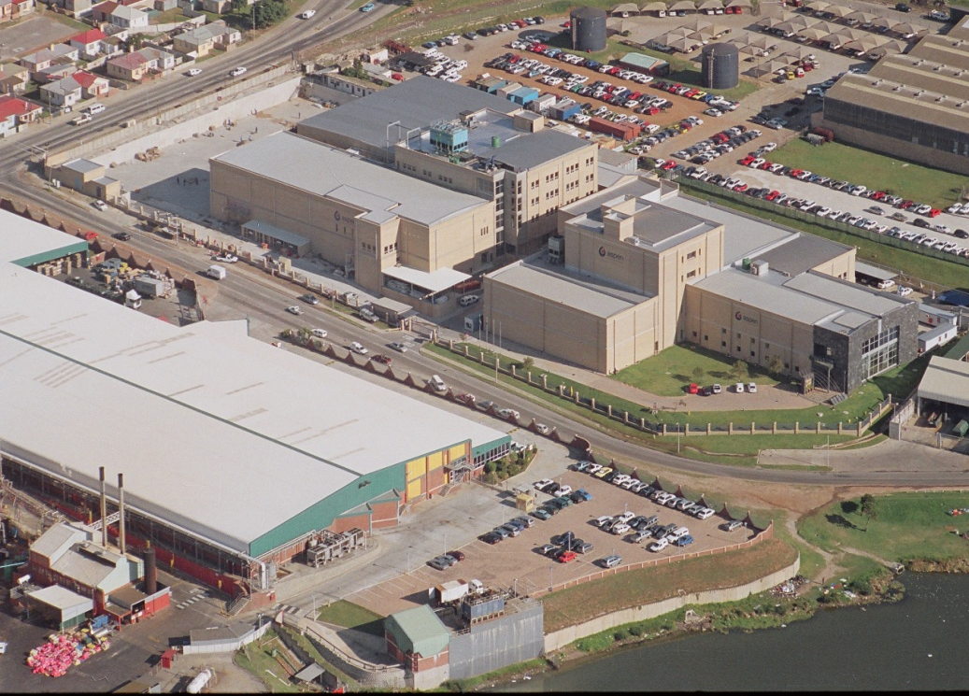
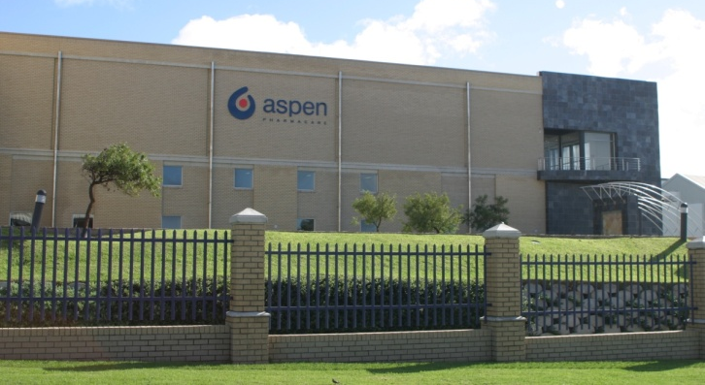
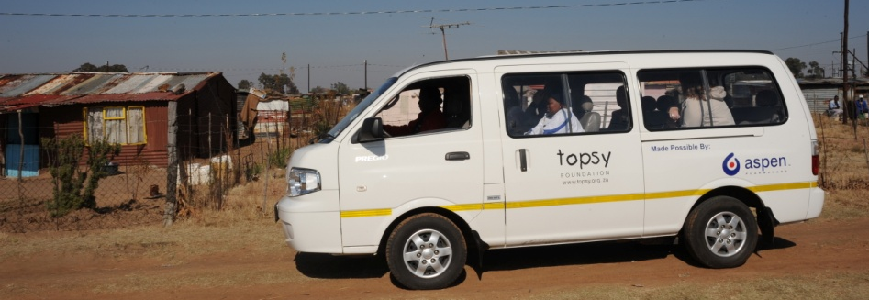
Aspen in South Africa

Slide 17
ASPEN IN SOUTH AFRICA - INTRODUCTION
Aspen’s legacy stretches back over 150 years in South Africa, linking back to Lennon in 1850
Through a passionate and committed team, the Group has achieved exceptional growth over the last 12 years:
CAGR of over 40% per annum
Aspen is South Africa’s number 1 pharmaceutical company in both the public and private sectors:
16.2% of South Africa’s total private market
33.7% of South Africa’s private generic market
Aspen’s product offering includes more than 2000 SKU’s
Aspen supplies one in four tablets to every public sector institution:
Share to increase
Aspen supplies nearly three in four ARV tablets sold by the South African government
Aspen supplies between one in four / five of every dispensed script by pharmacists in the South African private sector

Slide 18
ASPEN IN SOUTH AFRICA - INTRODUCTION
Aspen is one of the top 20 generic manufacturers worldwide
Aspen is arguably the largest manufacturer in the Southern Hemisphere, manufacturing in excess of 8 billion tablets with the capability of manufacturing, inter alia:
Steriles, lyophilised vials, liquids, semi-solids, oral contraceptives, infant nutritionals, fine chemicals, penems, hormonal vials, amps and FFS, cytotoxics, suppositories and injectables
Aspen is Africa’s largest pharmaceutical manufacturer:
16 Manufacturing facilities
Across 5 continents
Aspen is the only company on the continent with FDA / WHO accredited facilities both at a FDF and API level
Aspen is a global leader in generic ARVs:
Touch about 1 million lives per month

Slide 19
ASPEN’S PERFORMANCE IN SOUTH AFRICAN MARKET
Aspen has had an outstanding start in this financial year:
Sales ↑ 23%
Operating Profit ↑ over 50%
Pharma business continues its growth trajectory:
Price and volume increases
Favourable exchange rate
GSK business included for one month:
Business seamlessly transitioned
Consumer business has been affected by the economic cycles:
IMF business affected by the fire:
Expect to have manufacture back on line in July
Alternate supply sourced ex Europe
Public sector:
Recent awards confirm cost competitiveness:
Analysed later
Reliability proven during ARV scale up
Results have underlined resilience of Aspen and our competitive advantages within the market

Slide 20
THE MARKET PERFORMANCE
Total Private Market as at December 2009 R21.08bn (December 2008 – TPM R18.56bn)
OTC
R5.80bn
Ethical/Branded
R11.08 bn
Generic
R4.20bn

Slide 21
THE MARKET PERFORMANCE
South African Private Market Growth as per IMS – December 2009
MARKET
ASPEN
Total
+14%
+18%
Generic
+18%
+15%
OTC
+12%
+18%
Branded
+13%
+24%
Generics continue to outpace the market

Slide 22
ASPEN IN THE SOUTH AFRICAN MARKET
Total Pharma Market MAT Rand Share % as per IMS – December 2009
GSK incorporated

Slide 23
GENERIC PERFORMANCE IN THE SOUTH AFRICA MARKET
South African Private Market MAT Rand Share % (Sch 3-7) as per IMS – December 2009
Generics have a 27.5% value share

Slide 24
PERFORMANCE IN THE SOUTH AFRICAN GENERIC MARKET
Private Generic Market MAT Rand Share % as per IMS – December 2009
Market share lost in first quarter due to strike – recaptured in second quarter

Slide 25
ASPEN IN THE SOUTH AFRICAN MARKET
Total Branded Market MAT Rand Share % as per IMS – December 2009
GSK consolidated
retrospectively

Slide 26
ASPEN IN THE SOUTH AFRICAN MARKET
Private OTC Market MAT Rand Share % as per IMS – December 2009
Challenging for number 1 spot here

Slide 27
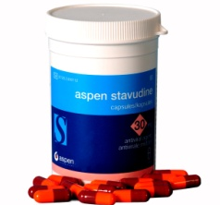
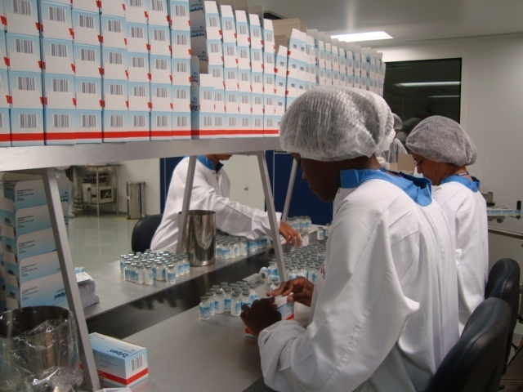
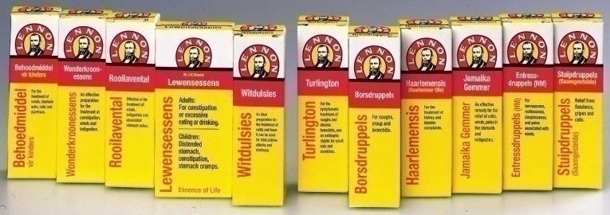
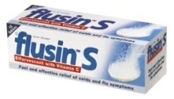
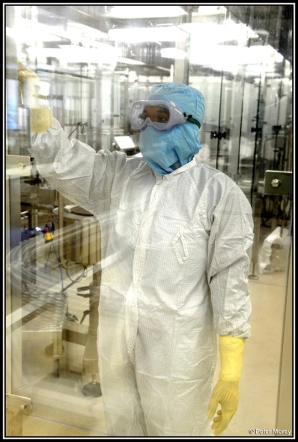
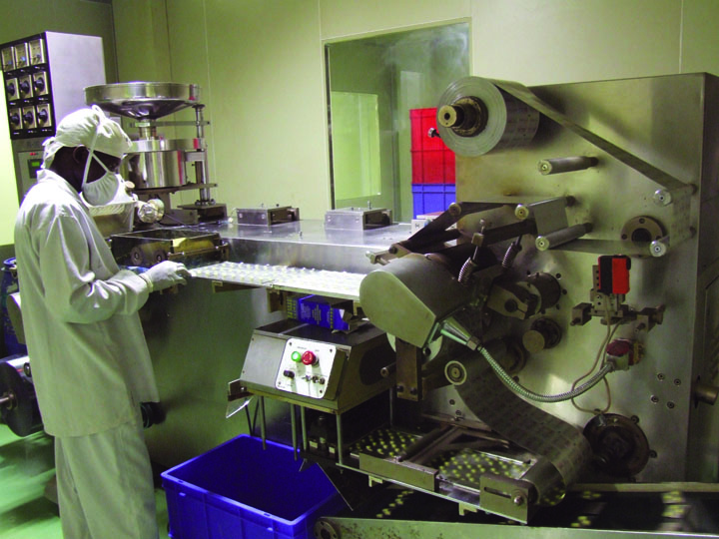
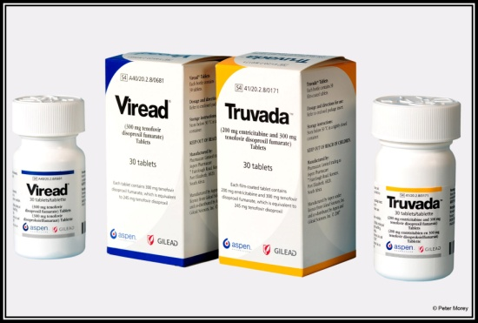
ASPEN’S SOUTH AFRICAN MODEL
People
Pipeline
Products
Cost
Aspen has a simple model
Business is simple – We don’t complicate it!

Slide 28
ASPEN’S STRENGTH OF REPRESENTATION FIELD FORCE SIZE IN SOUTH AFRICA
People
 | CUSTOMER SEGMENT | ASPEN RESOURCES
Private Sector | Prescribing GP’s | 275 Representatives
 | Dispensing GP’s
 | Pharmacies
 | Specialists
 | Private Hospitals
 | Key Accounts | 9 Key Account Managers
 | Funders and their intermediaries | 3 Key Account Managers
Public Sector | Provincial Medicine Depots | 7 Key Account Managers
 | Hospitals, Clinics, etc. (Medical, Pharmacy & Nursing) | 14 Representatives
Field force size affords Aspen a competitive share of voice and
comprehensive coverage of all important customer segments

Slide 29
TOP 20 THERAPEUTIC CLASSES – 1ST TEN
Products/Pipeline
MAT 11/2009
 | VALUE | GROWTH | SHARE
Selected Market Segment | 20,871,409 | 13.4 | 100.0
N2B Non-Narcotic Analgesics | 1,218,358 | 16.7 | 5.8
Aspen Group | 186,093 | 22.4 | 15.3
A2B Antiulcerants | 678,424 | 18.4 | 3.3
Aspen Group | 104,718 | 31.2 | 15.4
J5C Antivirals | 655,460 | 21.2 | 3.1
Aspen Group | 363,939 | 23.7 | 55.5
N6A Antidepress. Mood Stab. | 635,594 | 12.5 | 3.0
Aspen Group | 155,636 | 29.1 | 24.5
C10A Cholest & Trigly Regulator | 579,406 | 7.3 | 2.8
Aspen Group | 20,006 | 10.6 | 3.5
M1A Antirheumatic Nonsteriod | 533,724 | 11.2 | 2.6
Aspen Group | 114,152 | 23.2 | 21.4
J1C Broad Spectrum Penicill | 481,998 | 21.1 | 2.3
Aspen Group | 224,361 | 17.7 | 46.5
R5A Cold Preparations | 475,480 | 36.1 | 2.3
Aspen Group | 85,008 | 45.1 | 17.9
L1X All Oth. Antineoplastics | 419,452 | 12.0 | 2.0
Aspen Group | 1,257 | 67.6 | 0.3
A10C Human Insulin + Analogues | 407.029 | 13.9 | 2.0
Aspen Group | - | - | -
Aspen has a presence in 19
of the top 20 therapeutic
categories and in 14 of them
we are performing better than
the market

Slide 30
TOP 20 THERAPEUTIC CLASSES – 2ND TEN
Products/Pipeline
MAT 11/2009
 | VALUE | GROWTH | SHARE
Selected Market Segment | 20,871,409 | 13.4 | 100.0
N3A Anti-Epileptics | 359,082 | 20.4 | 1.7
Aspen Group | 49,761 | 26.3 | 2.4
J1D Cephalosporins + Combs | 350,949 | 11.5 | 1.7
Aspen Group | 74,829 | -5.4 | 21.3
R1A Topical Nasal Preps | 334,819 | 23.2 | 1.6
Aspen Group | 53,704 | 63.8 | 16.0
R5C Expectorants | 328,670 | 24.0 | 1.6
Aspen Group | 42,769 | 33.3 | 13.0
J1G Fluoro-Quinolones | 311,234 | 6.9 | 1.5
Aspen Group | 13,358 | 0.4 | 4.3
N1A Anaesthetics General | 309,099 | -4.0 | 1.5
Aspen Group | 35,550 | 20.1 | 11.5
C8A Calcium Antagonist Plain | 279,099 | 16.2 | 1.4
Aspen Group | 5,379 | 3.6 | 1.8
N5B Hypnotics + Sedatives | 272,981 | 18.0 | 1.3
Aspen Group | 50,298 | 25.1 | 18.4
R6A Antihistamines Systemic | 250,433 | 21.3 | 1.2
Aspen Group | 22,939 | 26.8 | 9.2
J1X Other Antibacterials | 248,158 | 37.3 | 1.2
Aspen Group | 12,173 | 4.0 | 4.9
Relevance of range displayed
by our presence across a
breadth of therapeutic classes

Slide 31
ASPEN IN THE SOUTH AFRICAN PRIVATE MARKET
Result of having the best people and relevant, quality products
MANUFACTURER | NO. OF SCRIPTS | % SHARE
ASPEN/GSK | 50,289,176 | 23.8%
ASPEN PHARMACARE | 44,709,665 | 21.1%
ADCOCK INGRAM | 30,892,927 | 14.6%
NOVARTIS | 16,034,743 | 7.6%
CIPLA-MEDPRO | 12,022,442 | 5.7%
PFIZER/WYETH | 9,601,399 | 4.5%
MSD/SCHERING | 7,117,345 | 3.4%
SANOFI AVENTIS | 6,479,418 | 3.1%
BAYER SCHERING PHARMA | 6,277,183 | 3.0%
RANBAXY/BETABS | 6,204,683 | 2.9%
JOHNSON AND JOHNSON | 5,938,691 | 2.8%
MERCK | 4,293,091 | 2.0%
ASTRA ZENECA | 4,137,070 | 2.0%
SERVIER LABS | 4,123,405 | 1.9%
PHARMA DYNAMICS | 3,650,463 | 1.7%
BOEHRINGER INGELHEIM | 3,369,168 | 1.6%
PHARMAFRICA | 2,530,265 | 1.2%
NOVO-NORDISK | 2,356,939 | 1.1%
RECKITT BENCKISER PHARMAC | 2,273,038 | 1.1%
INOVA PHARMA | 2,182,712 | 1.0%
ROCHE | 1,986,812 | 0.9%
Source: ImpactRx Report - this data was collected over the period January 2007 – June 2009
We don’t only detail our products –
we make sure they are actually dispensed

Slide 32
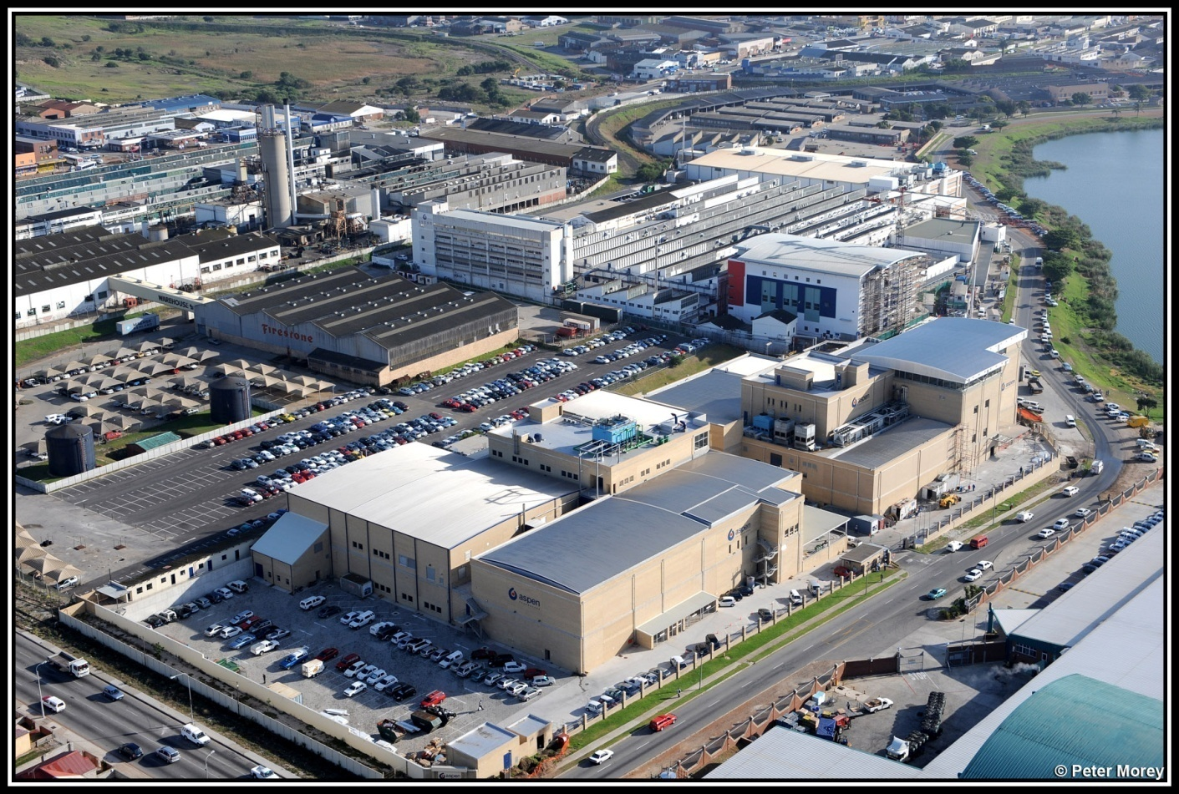
GLOBAL COST COMPETITIVENESS – FOCUS ON COST OF GOODS
Technical Centre
Heritage facility
SVP facility
OSD 2
SVP Warehouse
OSD 1 Packing
OSD 1 Manufacture
Realising the benefits of our ambitious build plan
Doubling capacity in OSD 1
7% incremental cost
Can double this again
Volume increases (including Global brand manufacture)
Significant cost reductions – consolidation of sites
Electricity
is 5% of
our
conversion
cost
Targeting a 50% reduction in conversion costs over 3 years

Slide 33
FOCUS ON GLOBAL COST COMPETITIVENESS
Result of cost reductions – RT289 Solid Tender
2009
2007

Slide 34
PROSPECTS FOR THE NEXT SIX MONTHS
Volume increases to continue
SEP price increase was in February 2009:
SEP increase in April/May 2010?
Relative increase versus last year will not include the same price effect
Incorporation of GSK business:
Will add about R400 million to sales for next six months
Continued conversion efficiencies:
Contribute to improved costs
ARV tender to be awarded in June:
Limited profitability:
Predominantly affects manufacture / jobs
Shifts will have more challenges operationally rather than commercially
Expect a further ramp up in lives to be covered
Well positioned to finish what we started

Slide 35
PROSPECTS – ASPEN IN THE SOUTH AFRICAN MARKET
For an additional challenge now we have
added a new ball for the team
We have said historically:
“The greatest reward for those of us working
within Aspen is the ability to successfully juggle”
Our own social contract of commitment to providing quality,
affordable healthcare
Being at the forefront of combating infectious diseases on the continent
Managing to provide superior returns to all our stakeholders

Slide 36
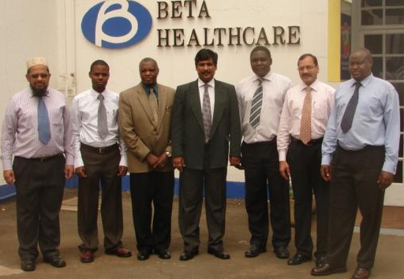
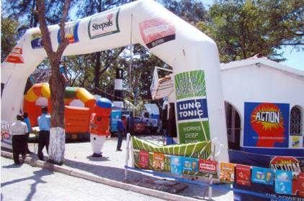
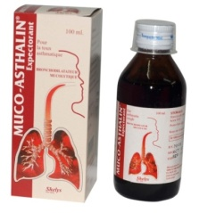
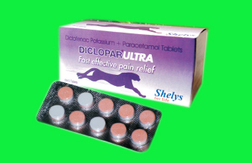
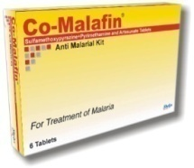
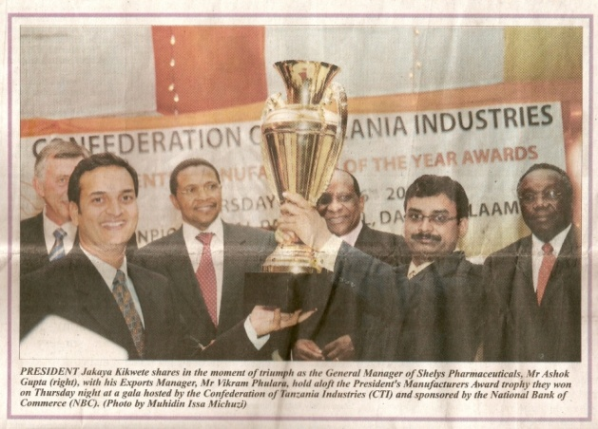
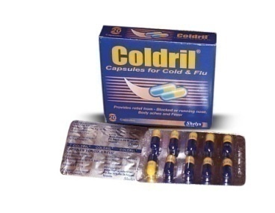
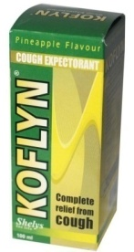
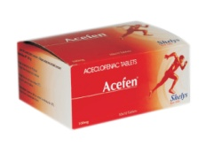
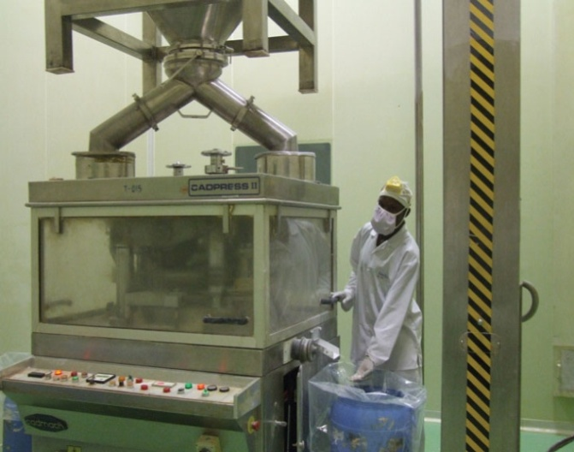
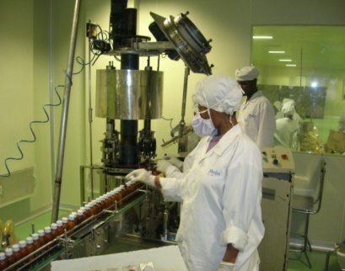
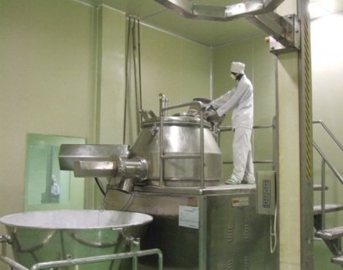
Aspen in Sub-Saharan Africa

Slide 37
REST OF SUB-SAHARAN AFRICA (SSA)
Current interest in SSA is in following broad categories:
Export from South Africa:
Negatively affected by ARV genericisation:
Commitment to procure API from licensor
Pipeline focus on hormonals, IMF, OTC and other niche products
Have infrastructure / capability to register Aspen-owned IP
Shelys/Beta in East and Central Africa:
Focus on private market paying dividends
Collaboration with GSK:
See attached geographical sales breakdown
Rolling out the regulatory process

Slide 38
SHELYS AFRICA & ASPEN EXPORTS
Six Months to December 2009
SHELYS/BETA
Shelys Africa consists of:
Shelys Pharmaceuticals (Tanzania)
Beta Healthcare (Kenya & Uganda)
Shelys Export – (focus on Southern/East Africa)
Sales force is in-house and contract rep teams
Total rep force : 98 + 19 contract
ASPEN EXPORTS
Local distributors for sales & distribution
8 reps and extensive distributor network
BETA
41 reps
R48m
ASPEN EXPORTS
8 reps
R63m
SHELYS
63 reps
R100m
SHELYS EXPORT
13 reps
R10m

Slide 39
GSK ASPEN HEALTHCARE FOR AFRICA
Calendar Year 2009 – Annual Sales
Extensive cover of 4 regions:
FWCA – 15 countries
AWA – 5 countries
EA – 9 countries
StnA – 9 countries
Sales teams mostly in-house
Some regions have additional contract / wholesale teams that work exclusively for the collaboration
TOTAL REP FORCE : 260
TOTAL SALES : $117 million
FWCA
70 reps
$30m
AWA
90 reps
$48m
EA
70 reps
$28m
StnA
30 reps
$11m

Slide 40
ASPEN IN REST OF SUB-SAHARAN AFRICAN (SSA)
These territories are particularly difficult to trade in
Individual territory market sizes are generally too small to warrant individual company representation
Supply chain including distribution and collection are significant barriers to entry
Have market coverage across all of SSA:
Currently hold 736 registrations
274 products in the registration process
1 261 registrations planned for submission in 2010
Deep understanding of each market and its needs:
In-country relationship with regulatory authorities
Over 360 reps and numerous distributors across the continent
Demonstrated manufacturing commitment in Africa
Number 1 together with GSK Aspen Healthcare for Africa in many if not most African markets with nearly $200 million of annualised sales:
Scale is a critical success factor in smaller markets

Slide 41
An investment with Aspen means not
only investing South Africa’s number 1
Pharma Company, but South Africa and the
rest of Sub Saharan Africa’s number 1

Slide 42
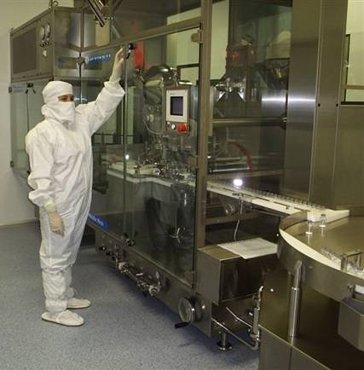
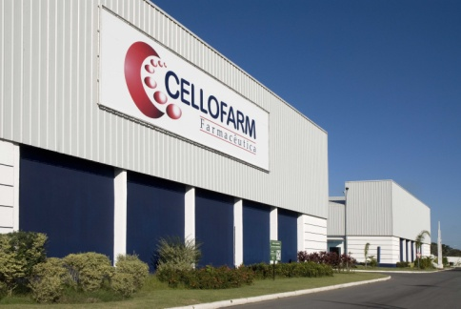
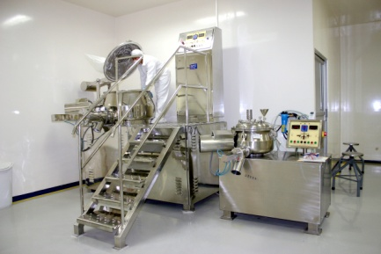
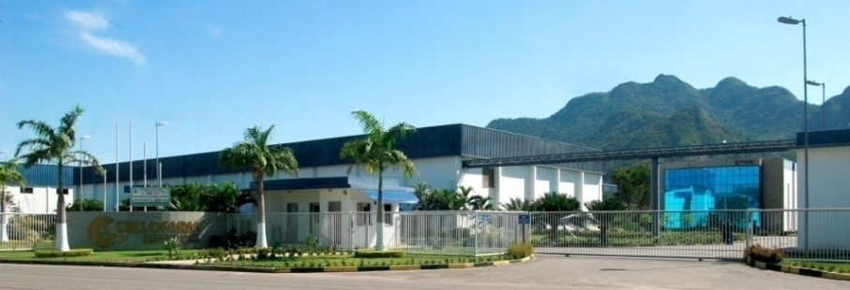
Aspen in Latam

Slide 43
ASPEN IN LATAM
Latam Sales by Territory - Six Months December 2009 : R500 million
Global brands constitute 31% of sales

Slide 44
ASPEN IN LATAM
Exercised option on balancing 49%:
Awaiting regulatory approval
Strides to pay ± $75 million to Aspen for Campos and other assets:
Facility better fit for Strides’ global strategy
Under recovers within Aspen infrastructure
Strides better positioned to manage commodity markets
Significant restructure of Brazil:
Headcount reduced from over 450 to less than 300
Net expenses reduced by over R100 million annualised
Advanced stage of negotiation to finalise branded opportunities
Organic pipeline in Brazil is significant:
We expect numerous important registrations within the next 12 months

Slide 45
ASPEN IN LATAM
Further insulin registrations:
Will make a contribution to the second half results
Brazil expected to return to profitability for the next six months:
Result of restructuring
Non-recurrence of current period once-off expenses
Profitability enhanced through:
Pipeline launch
Successful closure of current negotiations
Further transitioning of global products
Regional Global brand sales to double post transition
Now have both hands on the region the business is starting to take the intended shape
Already making a meaningful contribution to revenue:
Now resized to contribute to profitability

Slide 46
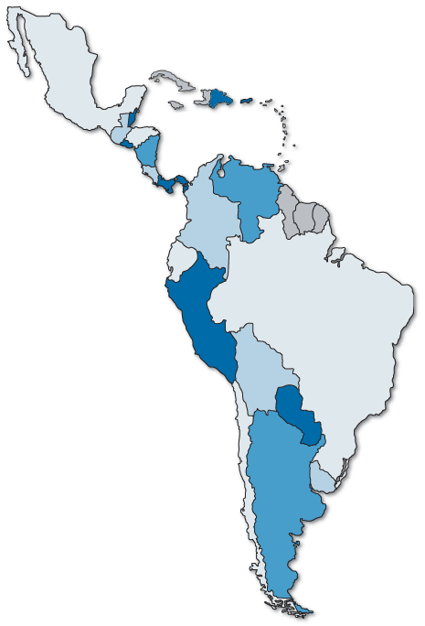
ASPEN IN LATAM
Mexico
99 reps
Increased representation in Mexico and Venezuela:
Support Global brands
Support own dossiers
Moved a team to be headquartered in Colombia:
Will include Venezuela
Colombia, Chile, Ecuador, Peru and Argentina being assessed
Venezuela
27 reps
Colombia
Ecuador
Peru
Brazil
123 reps
Chile
Argentina

Slide 47
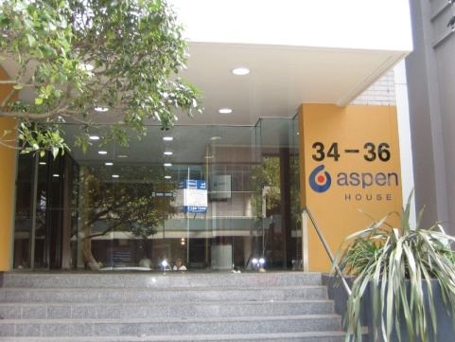
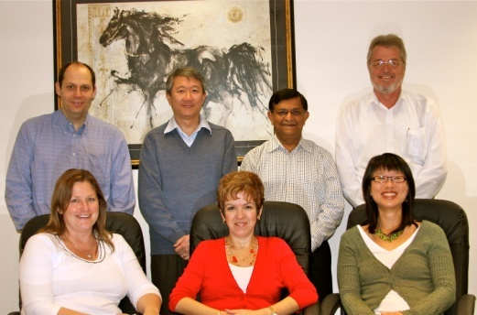
Aspen in Asia Pacific

Slide 48
ASPEN IN ASIA PACIFIC
Asia Pacific Sales By Territory
Australia – 72% of sales
Asia will continue to grow:
Aspen Asia fully functional
Head quarters in Hong Kong
Volumes in Japan up by 10%
Outstanding management team
Growth trajectory continues
Six Months to December 2009 : R748 million

Slide 49
ASPEN IN ASIA PACIFIC - PROSPECTS
Additional growth from further licensing agreements and pipeline:
Will add to the second half of financial year
Reviewing opportunities in South East Asia:
Intention to establish infrastructure in Philippines
Base to supply ASEAN market
Regulatory harmonisation
Significant contributor to Aspen Group:
This will continue
Global brands for the region to increase
Opportunities within Australia being explored
Investment region for Aspen

Slide 50
SUMMARY AND PROSPECTS
Currency balance demonstrated:
Will continue into the future
Shift balance between South Africa and Global contributions
GSK transactions to be included in next six months:
Contribute to both sales and operating income
Anticipate sales of nearly R900 million in the next six months
Strong cash flows to continue
Manufacturing investment paying dividends:
Volumes ↑
Costs rationalised
Reduced conversion cost
In South Africa:
Sales growth influenced by SEP increase and timing
Volumes growth to continue
Simple plan – simple focus:
People, relevant products, pipeline and costs
We have done this for years and we are sticking to the formula

Slide 51
SUMMARY AND PROSPECTS
Sub-Saharan Africa:
GSK Aspen Healthcare commences and will be the major contributor
Focus on pipeline enhancement with over 1000 filings planned in next 12 months
Latam:
Restructured and reshaped
Expect positive performance for the next six months
Asia Pacific:
Continues to deliver and Asia becoming more significant
Global brands:
Continue growth through increased representation in emerging markets
Increased costs of distribution
Cogs reductions will be significant in medium term
Expect growth to be sustained with currency influencing geographic profitability and a continuation of our strong cash flows and profitability

